Slide 1
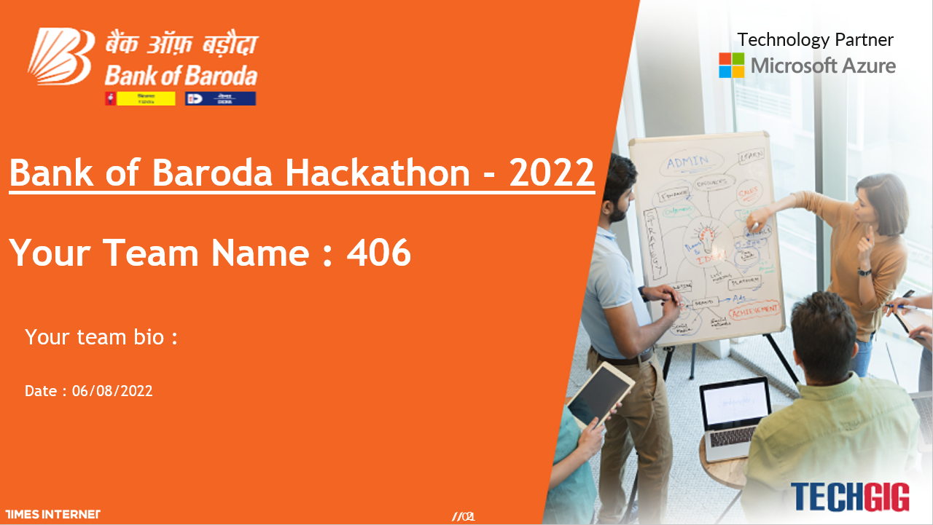

Slide 2
PERSONALISED FACE RECOGNITION ASSISTANT- IDA

Slide 3
PROBLEM SATEMENT
There is a need to automate tasks at complex organizations to make sure the operations are quick and smooth. The endless possibilities of virtual assistants help satisfy the need. Virtual Assistant may help to increase the adoption of digital channels and reduce the cost of operation.

Slide 4
TEAM
MEMBERS- Gopika Nair
Lakshmi Sahithi Budamagunta
Tarumani Vyshnavi
Simerpreet Kaur

Slide 5
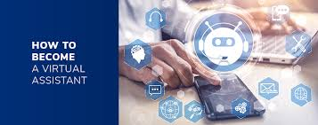
TABLE OF CONTENTS
INTRODUCTION
EXISTING WORK WITH LIMITATIONS
PROPOSED WORK AND METHODOLOGY
NOVELITY OF THE PROJECT
REAL TIME USAGE
HARDWARE AND SOFTWARE REQUIREMENTS
OVERALL SYSTEM ARCHITECTURE
LITERATURE REVIEW
MODULE DESCRIPTION
MODULE WORKFLOW EXPLANATION
IMPLEMENTATION AND CODING
SNAPSHOT
TESTING
RESULTS AND DISCUSSION
CONCLUSION

Slide 6
INTRODUCTION
Virtual assistants are one of the most successful applications of AI and have become an indispensable part of the technology. They can be used in almost every field to make our tasks simpler and efficient.
In Today's advanced market ,artificial intelligence could be a key unlocking the possibilities of tomorrow. Users like to associate with the machines using voice commands which are conceivable through the virtual assistant.
They have vast possibilities where New features and upgrades can always be added to improve the performance.
Through our project, we aim to add new and various features to this amazing virtual power. Our virtual assistant is improved by giving Facial Recognition framework using AI strategies to detect and recognize faces.

Slide 7



EXISTING WORK WITH LIMITATIONS
The most common personal assistants like
Google Assistant and Siri, focus primarily on helping users with non-work related tasks like leisure and fitness.
Cortana, focuses on work efficiency.
Alexa, is more concerned with retail.
Security is the significant issue with the voice-helped gadgets while anybody can access to a voice-actuated gadget.
Voice assistance can be utilized without getting any permission from the user where one can gathers data about the records and administrations related with the dynamic gadget, and request that it perform errands which can be unsafe and can cause misfortune as well.
It comprises of high security hazard as these gadgets may uncover the schedule substance, messages, and other individual subtleties.

Slide 8
LIMITATIONS OF EXISTING ASSISTANTS
Apps like Youtube, Google cannot be opened
Emails or voice memos cannot be sent and read
PERSONALISED EXPERIENCE
FACE RECOGNITION
Remainders, alarms, notes are mixed up if more than 1 person use the same assistant
It cannot recognise faces, hence data privacy maynot be maintained
APP LAUNCH
SEND EMAILS

Slide 9
PROPOSED SYSTEM
The Facial Recognition to the virtual assistant gives greater security to the system by the Haar Cascade algorithm. The face is recognized by the camera and it is handled through OpenCV in which it detects the faces and articles placed put before the camera and the pictures taken is contrasted with the pictures in the in the system by Haar Cascade Algorithm. After recognizing the face it permits to interact with the virtual system. The virtual assistant hangs tight for our voice commands. The user’s input is captured by the microphone which is then converted to text format using the Speech To Text synthesizer and this command is then processed and will look for the relevant output.

Slide 10
PROPOSED WORK AND METHODOLOGY
Users will have to register with his credentials. The captured file is uploaded to the server.
The user will have to login where the file uploaded to the server undergoes face detection.
After successful login, IDA opens up user's data and shows the available features.
When giving commands using speech function , the software converts the speech to text .
Converted text is then converted to command that is understandable for computer.
Now the mapped computer command, go to server through internet. Simultaneously, the speech is evaluated locally.
The user will be shown with the response results for his requests like weather report, news, reminders, search, etc.

Slide 11
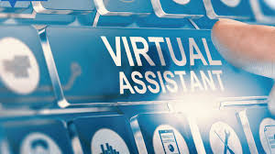
NOVELITY OF THE PROJECT
Alongside performing the general tasks like any other personal assistant, IDA recognises its users through facial recognition system. It gives personalized experience to the users. When a single assistant is used among 2 or 3 people, it creates different profiles and each user is recognized through facial recognition, unlike the existing personal assistants. Each user is specifically reminded of the scheduled activities, Which makes it unique and a step ahead assistant. Therefore , in being able to give a broader and personalised experience lies it's novelty.

Slide 12
REAL TIME USAGE
IDA can be used anywhere, anytime just like any other personal assistant. Along with performing a few general tasks like making call , sending message, playing music providing an unforgettable personalized experience. If there are more than one users , IDA can segregate different user's data and private space . After securely recognizing the user , it will provide them with their daily reminders and personalized applications and services .This implicates that every user will have their own database that cannot be revealed to any other user. It can launch apps like youtube, google with just a voice command. It can create voice memos and send emails. It can perform general tasks like wikepedia search, weather report. Though these features already exists, the implementation and design are different.

Slide 13
HARDWARE AND SOFTWARE REQUIREMENTS
Basic System Configuration :
COMPONENT | MINIMUM | RECOMMENDED
PROCESSOR | 1.8 Ghz Dual Core Intel Pentium/AMD Athlon 64 X2 | 2.1 GHz Intel Core i3-5010U 5th Generation
RAM | 2GB | 8 GB
CAMERA | 8 Mega-Pixel | 16 Mega –Pixel DSLR
DISK | 128 GB | 512 GB
NETWORK | 1MB/s plan | 3MB/s

Slide 14








PACKAGES REQUIREMENT
WIKIPEDIA
DATETIME
WEB BROWSER
REQUEST
SUBPROCESSES
OS
SYS

Slide 15
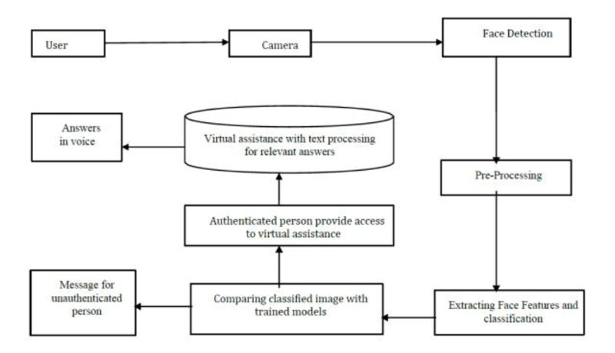
SYSTEM ARCHITECTURE

Slide 16
SYSTEM ARCHITECTURE
In the Proposed System architecture camera captures the photo of the user and then it trains the models for the images stored in the database with respective to the features of the person. In the detection section it detects the face based on the haarxml file which has some pre-defined features of face. After detecting the face, it will start extracting the features of the face. By considering the features the images are classified accordingly. These classified images are compared with the trained models. If it matches the user can access the virtual assistance.

Slide 17
LITERATURE REVIEW
From the initial researches, a large number of studies were found, perhaps surprisingly, given that Virtual Assistant technology is relatively young. It is only ten years since the introduction of the first popular VA, Apple's Siri.
The Most famous application of iPhone “SIRI”, helps the end user to communicate end user mobile with voice and it also responds to the voice commands of the user.
It is named as Personal Assistant with Voice Recognition Intelligence, which takes the client contribution to type of voice or content and process it and returns the yield in different structures like activity to be performed or the item is directed to the end client.

Slide 18
Similarly, Amazon’s ALEXA, Microsoft’s CORTANA, Google’s GOOGLE VOICE ASSISTANT, Samsung’s BIXY have emerged in the later years. The functions of all these assistants are mostly same leaving some exceptional features.
Recently, there is a usage of new and different types of assistants in various fields and their growth for different purposes and different people has started to rise. Rutuja V. Kukade (2018) et al. proposed there are various communication barriers for people who are blind , and they have to face various challenges. Working on such limitations is currently the new aim for enthusiasts.
In this project, though we did not take up on solving big challenges, we focused on improvising the general personal assistant with features unavailable in these popular assistants and linking face recognition.

Slide 19
MODULE DESCRIPTION

Slide 20
SPEECH RECOGNITION
Speech is recognized using speech_ recognition module and other packages like pyaudio. Using speech recognition, user’s input is captured by the microphone and speech function is then converted to text format.
SPEECH TO TEXT
Command in the form of speech is converted to text for the program to interpret user’s need. It is done by speech to text synthesizer.
FACE RECOGNITION
Face is recognized with the help of face_recognition module. OpenCV detects the face by Haar cascade algorithm. After recognizing the face it permits to interact with virtual assistant.

Slide 21
TEXT ANALYSING
The text is analysed and is linked to one of the modules based on the keywords.
INTERPRETING COMMANDS
If the keywords in the text matches a particular module, then that particular function is implemented.

Slide 22
MODULE WORK FLOW EXPLANATION
It is fully modular and has a set of services. Each service offers some task to do which then combines its data to give fully functional virtual assistant. Following is a brief idea about how the virtual assistant is going to function.
It starts with the first step of facial recognition. If the user is detected it transfers to the next step else the prompt is provided as “User not detected want to register as new user”.

Slide 23
Once the user is detected the application is connected to the database having the data of the particular user and the assistant is ready for the query. The user can start the conversation ask a question or do as the user wish.
User can query the assistant about anything using voice command. The user’s command is converted to text which is understood by the machine using a STT (Speech To Text) synthesizer.
Then the assistant will match the user’s phrase to the particular module and will perform the specified task on the devices.
The proper reply is generated using the knowledge database. Once the reply is generated the text is then converted into speech and the output is produced through speakers.

Slide 24
This assistant is mainly divided into three services which handle most of the data.
Face Detection Service: The Face Detection Service allows the virtual assistant to detect the presence of the user in front of the device and verify its user data using the face in the image and database. Face Detection Service continuously scans the video input from the camera or webcam. As soon as face is detected virtual is available for further query. Face Detection Service uses the face_recognition module and OpenCV packages.

Slide 25
The face recognition algorithms break the task of identifying the face into thousands of smaller, bite-sized tasks, each of which is easy to solve, known as classifiers. A face may have 5000 or more classifiers, all of which must match for a face to be detected. Since there are at least 5,000 or more tests per block, To solve this, OpenCV uses cascades. The OpenCV cascade segments the problem of detecting faces into multiple stages. It performs a detailed test for each block.
Viola jones algorithm is used
The algorithm uses 4 techniques
1.Haar –like features
2.Integral images
3.Ada boost
4.Cascading

Slide 26
This algorithm trains a system to identify the difference between face images and non-facial images. We extract the features of a face image and store it in a file,if a given input image processes all the comparison in the file then it is recognized as a facial image. We are classifying the image as a face or a non-face image, just by referring to the file which is already stored in the database .
Captured image undergoes face detection. Detected face will be cropped and stored in database.
Where in case of face recognition if there is any movement ,video surveillance will be used to detect the
moving object.

Slide 27
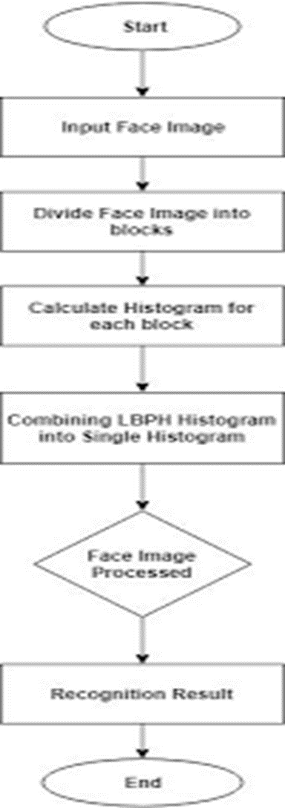

Slide 28
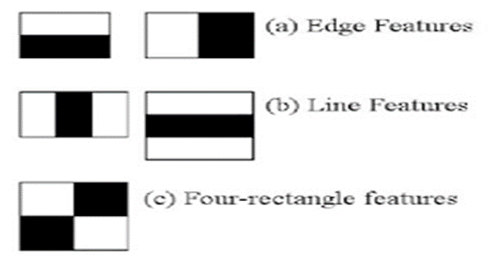
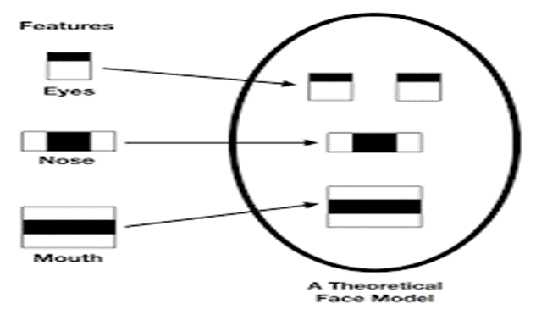
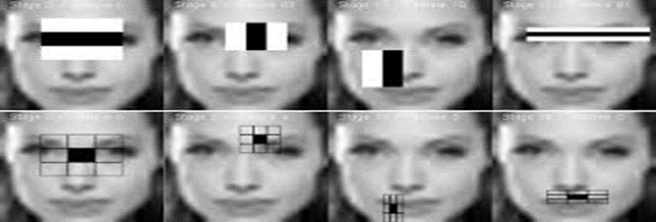
HAAR FEATURES AND CASCADING

Slide 29
Speech Detection Service : The Speech Detection Module allows the virtual assistant to record the user’s voice data using the microphone which then stores into the user database for the speech recognition. It also has the functionality of speech synthesis which converts the text on screen to the audio.
Dialogue Manager Service : The Dialogue Manager is the soul of a virtual assistant as it generates the query reply using its knowledge database. It has the functionality to give the most effective and best reply to the query asked by the user. The user input is mostly textual or vocal which the processed using the service which is used in the Dialogue Manager. Dialogue Manager is the key service which has the most complex task to do and give the accurate reply to the query.

Slide 30
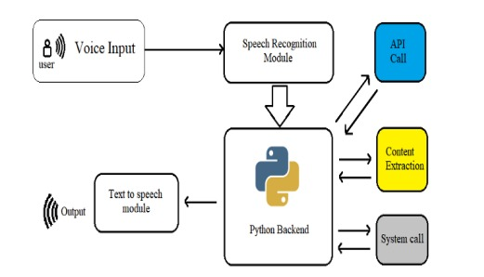

Slide 31
IMPLEMENTATION AND CODING

Slide 32
IMPLEMENTATION OF FACE RECOGNITION

Slide 33
1. Pre-Processing
2. Face Detection
3. Model Training
The model is trained by passing 20-25 training images of the faces of each of the students. The training method data_prepare detects the face using the faceExtractor method and assigns this image to the particular unique student label.
Images fed to the algorithm are grayscale as color has no effect nor contribution to the facial detection or recognition stages. OpenCV methods are used to convert all images to grayscale before any processing of that image occurs at any stage.
We employ multiple classifiers to detect images. We use one classifier based on Local Binary Patterns Histogram and the other using Haar Cascade features. The face Extractor method uses the classifier to extract and return face coordinates in an input image. This method is used in the data preparation or model training stage to train each face with its associate label.

Slide 34
To build a personal voice assistant it’s necessary to install the following packages in your system using the pip command. All the code is implemented in VISUAL CODE STUDIO.
Pyttsx3: It is used for text to speech conversion.
Datetime: It is used to access the current date and time.
Speech recognition: It recognizes the user commands.
Wikepedia: This module is used to access the wikedia search for searching the desired input .
smtplib: It sends the emails with HTML content and attachments.
Webbrowser: It directly searches in the web browser based on user’s request.
Os: It provides functions for creating and removing a directory (folder), fetching its contents, changing and identifying the current directory, etc.

Slide 35
8. psutil: It is a cross-platform library for retrieving information on running processes and system utilization (CPU, memory, disks, network, sensors)
9. pyjokes: It creates random jokes and displays on user’s command.
10. pywhatkit: It is used for you tube search, sending whatsapp messages etc.
11. Wolframalfa: It is used to access wolfram alfa engine for solving computational and geographical questions.
12. requests: allows you to send HTTP requests using Python. The HTTP request returns a Response Object with all the response data (content, encoding, status, etc).
13. json: It is used to access weather forecast.

Slide 36
Setting up the speech engine:
The pyttsx3 module is stored in a variable name engine. The voice Id can be set as either 0 or 1, 0 indicates Male voice and 1 indicates Female voice.
Now define a function speak which converts text to speech. The speak function takes the text as its argument, further initialize the engine.
runAndWait:
This function Blocks while processing all currently queued commands. It Invokes callbacks for engine notifications appropriately and returns back when all commands queued before this call are emptied from the queue.

Slide 37
Setting up the command function for your AI assistant :
Define a function takecommand for the AI assistant to understand and to accept human language. The microphone captures the human speech and the recognizer recognizes the speech to give a response.
The Main function:
The main function starts takes the commands given by the humans and stores in the variable statement. If the following trigger words are there in the statement given by the users it invokes the virtual assistant to speak the commands.

Slide 38
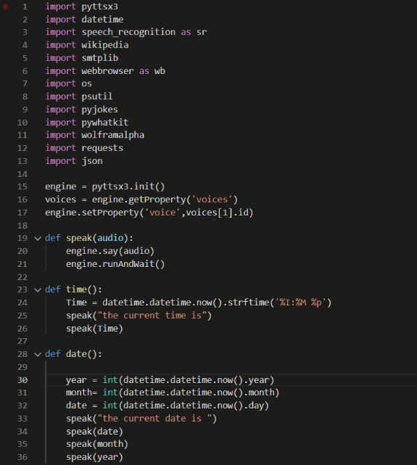

Slide 39
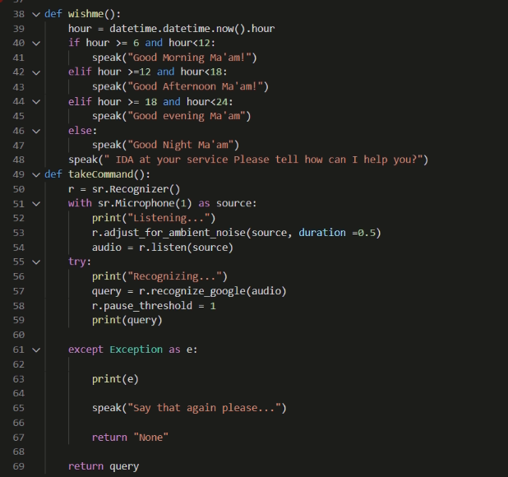

Slide 40
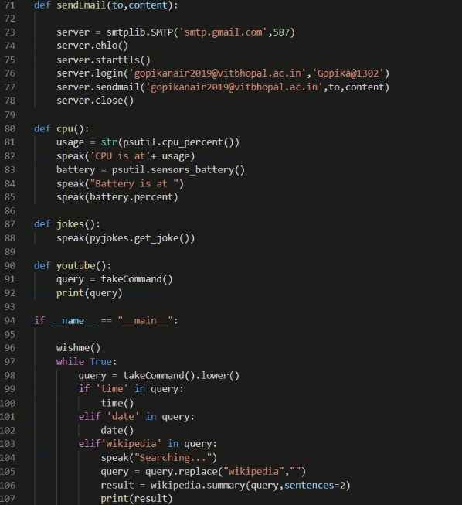

Slide 41
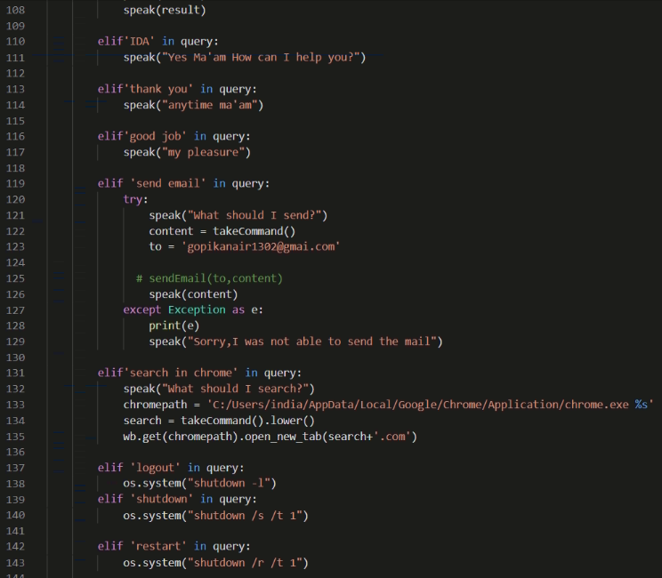

Slide 42
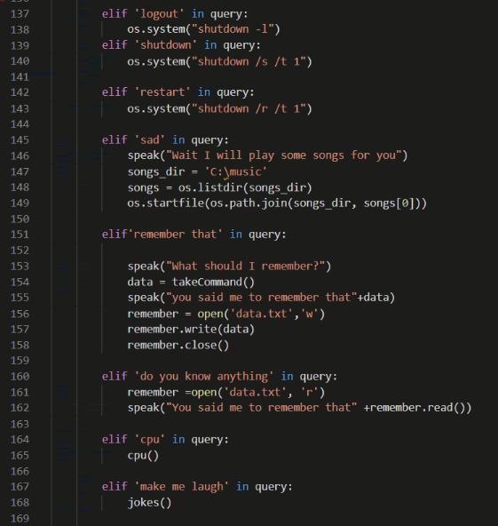

Slide 43
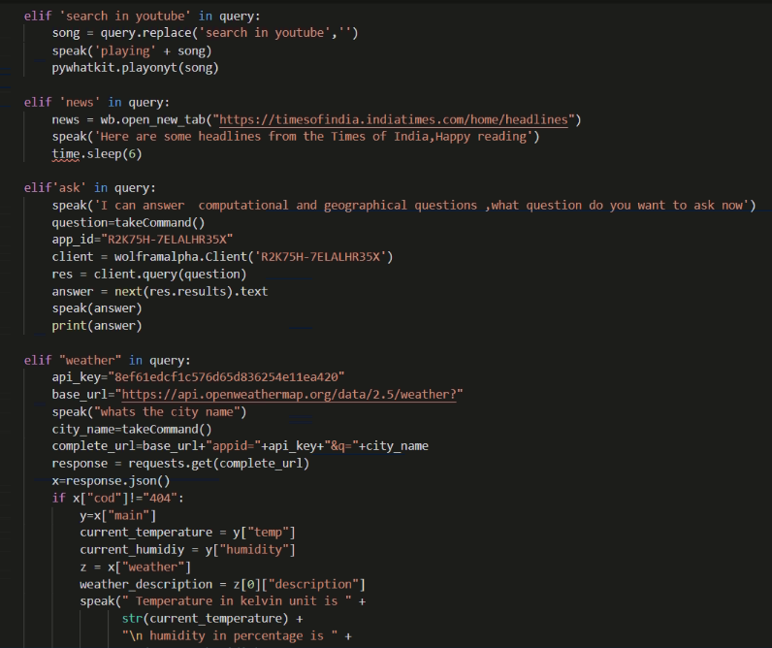

Slide 44
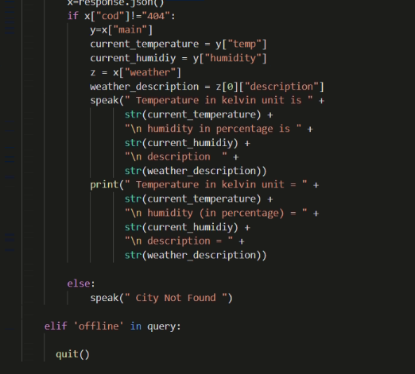

Slide 45
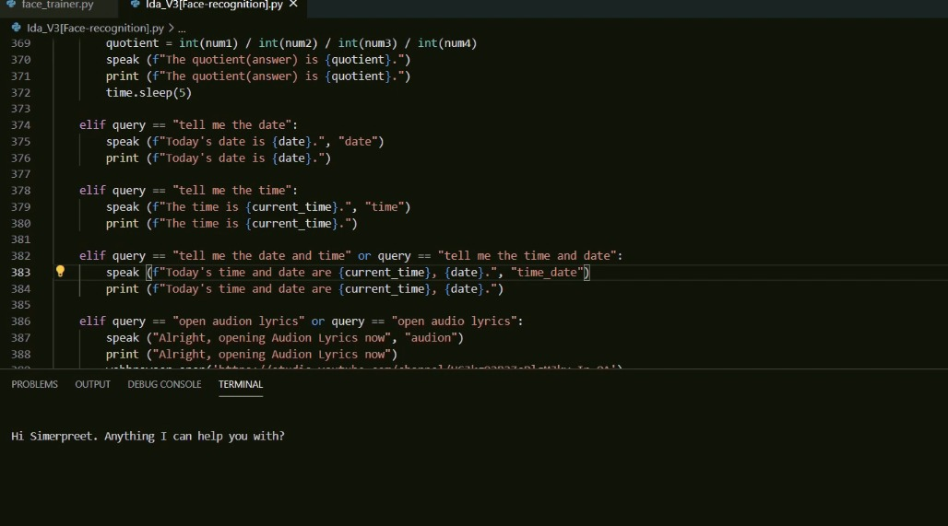

Slide 46
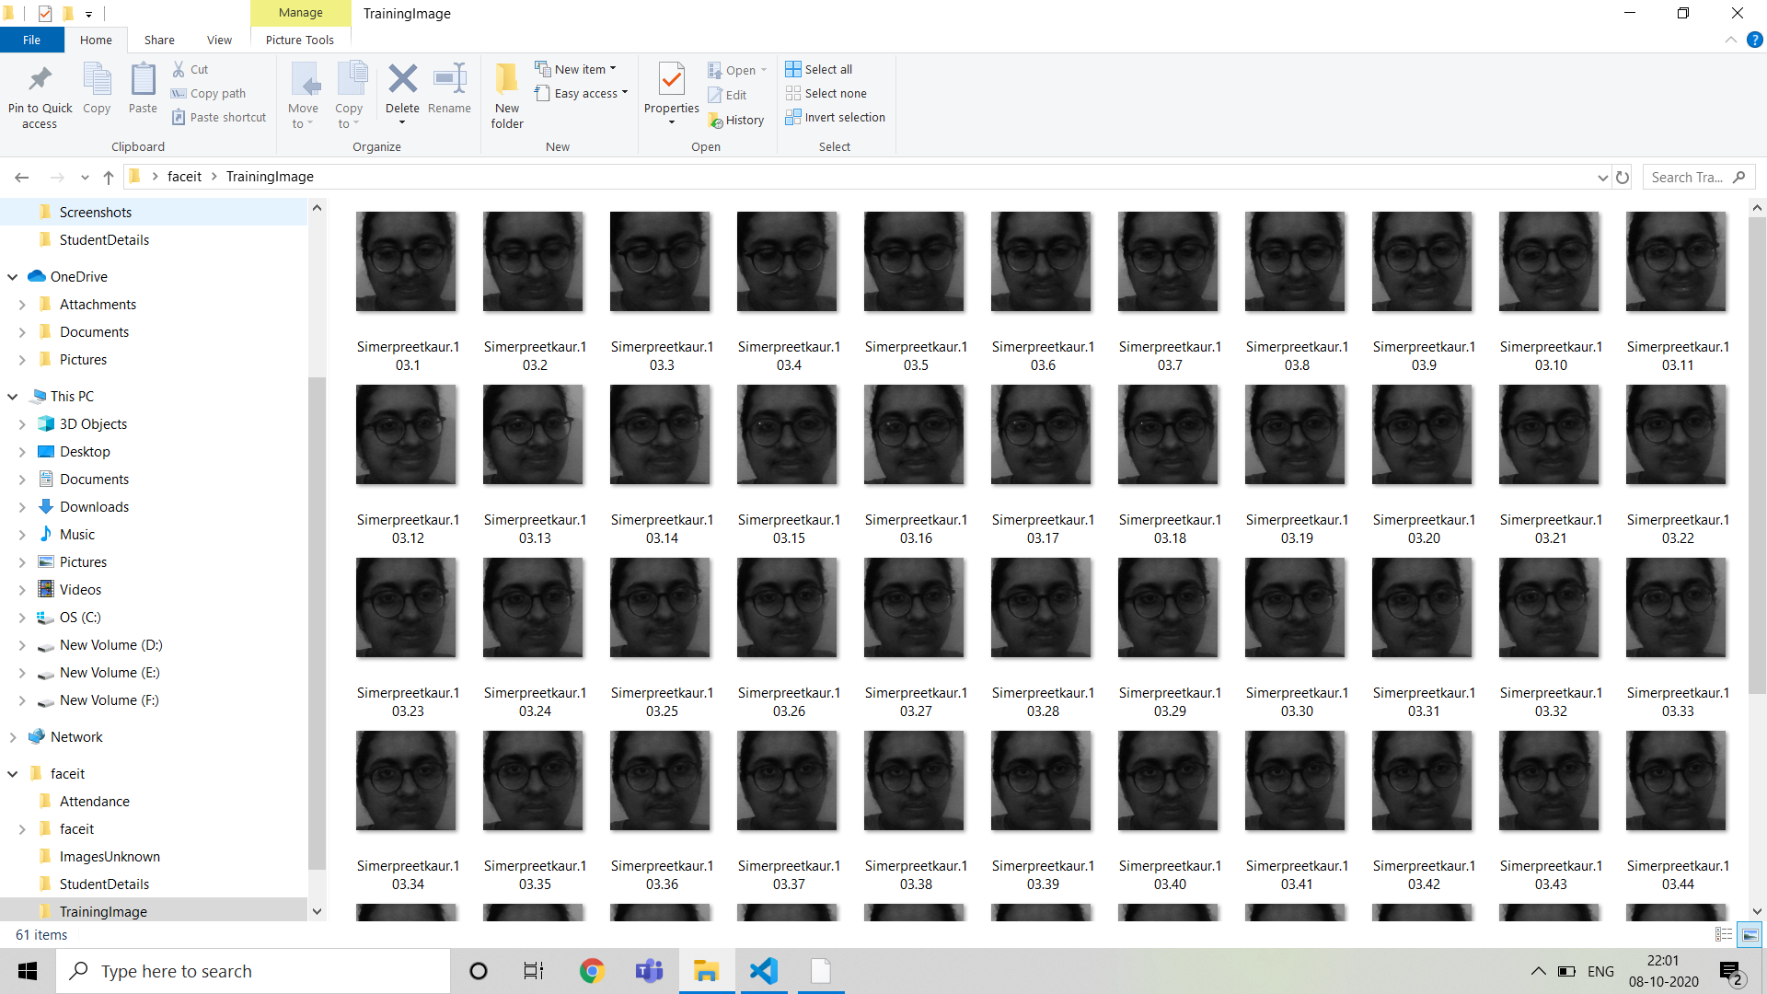

Slide 47
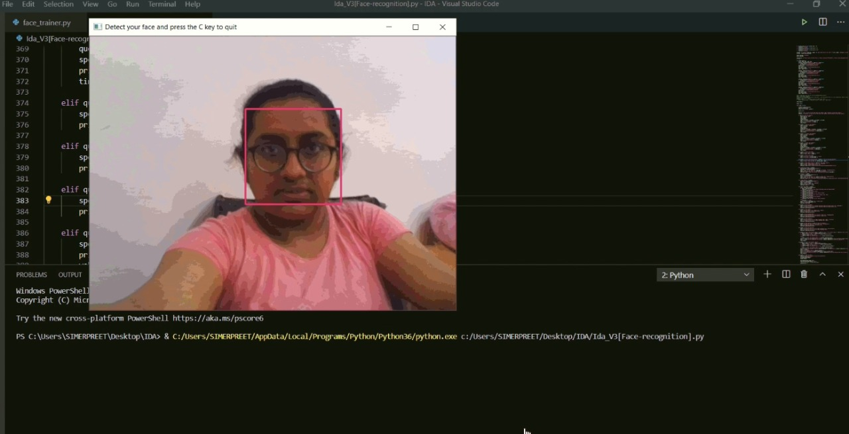

Slide 48
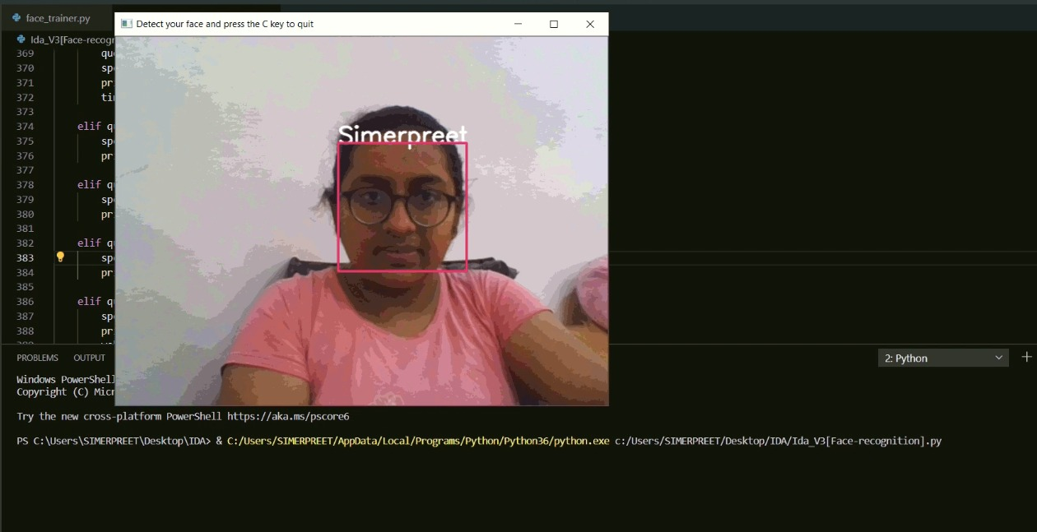

Slide 49
TESTING
This personal face recognition assistant was implemented in two stages.
In the first stage, a basic voice assistant was made and in the second stage face recognition was connected to it.
STAGE 1:
First, we focused on implementing the basic personal voice assistant that can work accurately.
All the basic functions like date and time, weather etc were added in the beginning and then complex functions like sending an email were added next.
Speech recognition, giving input command, output time were the biggest challenges faced in this first stage.

Slide 50
The output of this stage produced satisfactory results.
We were able to get all the desired tasks done without facing any complications. The runtime was low and the accuracy was high which made the attempt a success.
STAGE 2:
After successful completion of stage 1, we started working on face recognition.
Using various libraries and algorithms mentioned earlier we made a model to recognize the users based on the training data stored in database.
In the testing data, we added images of known and unknown people.

Slide 51
The output of this stage was not satisfactory in the beginning as the results were less accurate.
The code was then modified and some changes were made in the approach
After modification, for testing we took the image of a sample user and image of Billgates for recognition. The model could differentiate both the images signing us that it is working correctly.
The next step was linking the face recognition database to the assistant.
Another level of testing was taken and the assistant gave desired results with better accuracy.
Finally, after the completion of implementing the above two stages, the project was complete and the end result was very much good with high level accuracy and low run time which made the project successful.

Slide 52
RESULTS AND DISCUSSION
INPUT
FaceRecognition
A machine learning model was designed and developed using the OpenCV to perform facial recognition and liveness detection. This was followed by implementing a dynamically run source code to create data sets upon which the model was trained.​
The datasets were created when the user takes a picture of himself while following the process. The model was then trained with pictures.
These trained pictures are stored and used for recognition when the user wants to login to the assistant.

Slide 53
Voice recognition
The user is lead to the assistant after the recognition.
The assistant responds when the user calls the wakeup word and it asks for user input.
User can now ask any query for the assistant to perform.
OUTPUT
Face recognition
A person who appears for scanning is recognized and detected after being compared to preloaded database.​ After comparing with the database and matching with the user id and name, the person is directed to the assistant.
Here ends the first stage ,that is facial recognition.

Slide 54
Voice Recognition
The assistant will open and ask you for input and will reply according to the voice command of the user.
It recognizes the user command based on keywords (like search, wikepedia. What do you know e.t.c. ). If it doesnot understand the voice command, it will ask you to repeat.
The action is performed and the result is returned in the form of speech along with the text display on the screen.
The results of some of the sample inputs are given below.
Google searching engine, the Google search engine is activated by the user commands which contain ‘Google’ or ‘Search’. By detecting the search keyword and search request, the Google search engine will returns the search result displayed.

Slide 55
“Google India”, the keyword ‘Google’ is detected and the result will be presented on the web browser by searching ‘India’ on Google.
“Try to Google Java API”, the user can have the keyword Google in the middle of a request and the result of searching ‘Java API’ on Google will be displayed on the web browser.
“Search for apple”, the user can also use the keyword ‘search’ to do the Google search, this command will have the result of searching ‘apple’ on Google.

Slide 56
CONCLUSION
The personal voice assistant system presented is a very fundamental system with few features however the additional and advanced features may be introduced as future work of this project , In this project the design and implementation of a Intelligent Personal Voice Assistance with face recognition is described. The project is built using available open source software modules with visual studio code community backing which can accommodate any updates in future. The modular approach used in this project makes it more flexible and easy to integrate additional modules and features without disturbing the current system functionaries.

Slide 57
It not only works on human commands but also it is designed for give responses to the user on the basis of query being asked or the words spoken by the user such as opening tasks and operations. It has an enormous and limitless scope in the future. Like Siri, Google Now and Cortana most popular personal voice assistants, this project will easily be able to integrate with devices near future for a Connected Home using Internet of Things, voice command system and computer vision.

Slide 58
THANK YOU

